Slide 1

GROUP Project – spaceship titanic
Purpose: to create the most accurate prediction of survival on the Titanic
Tools: Jupyter Notebook
Method: Carrying out data formatting with subsequent analysis and visualization for more accurate results.

Slide 2
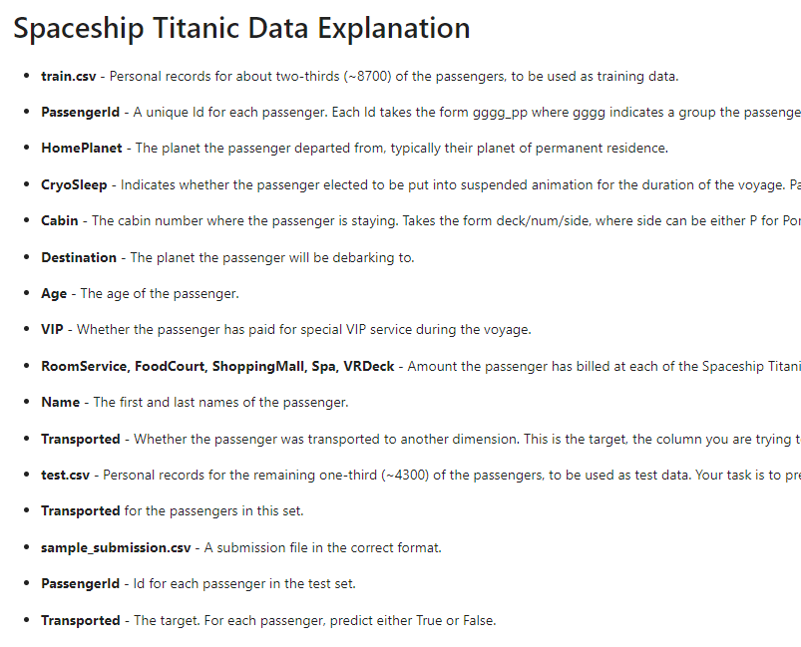
DATA

Slide 3
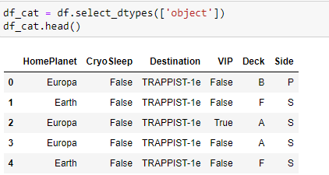
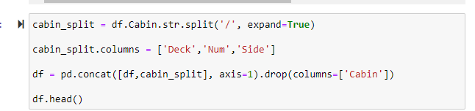

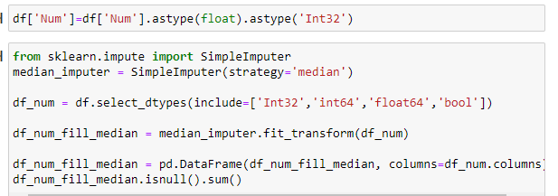
Preprocessing
Use split to find more variables.
Use fillna() to fill the NaN values before coding
Strategy for categorical values = most_frequent
Strategy for numerical values = median

Slide 4

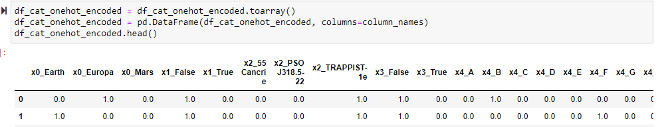
Integration
Take variables for future prediction and use OneHot Encoder for categorical variables

Slide 5
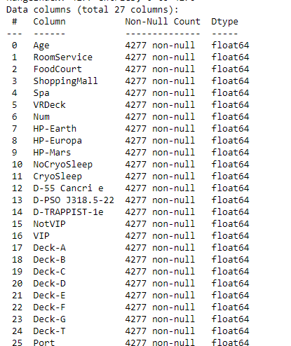
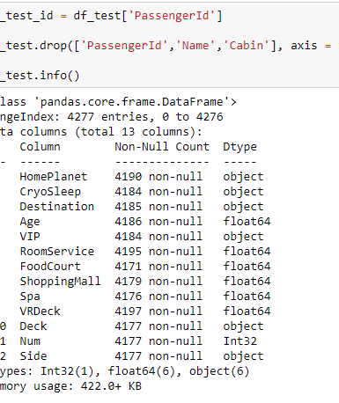
Summarization
Using same methods (split(), fillna (), onehot, drop(), astype()) for test data and turn raw data into useful for prediction data

Slide 6
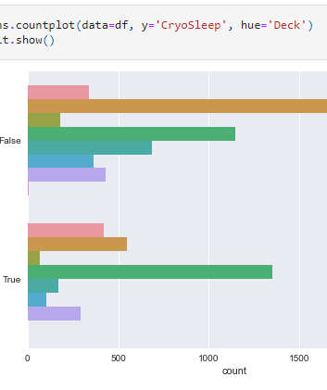
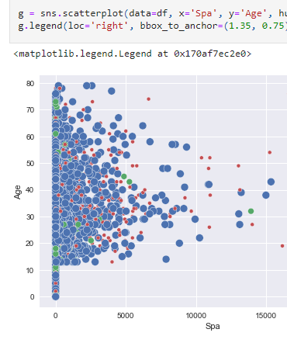
Visualization
Using visualization to find useful variables

Slide 7
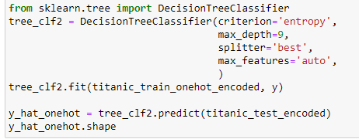
Model 1 (Decision Tree Criteria = Entropy)
For this prediction model use this features because for entropy model it’s the best combination of them
Pretty long data preparing for this model but it’s worth it

Slide 8
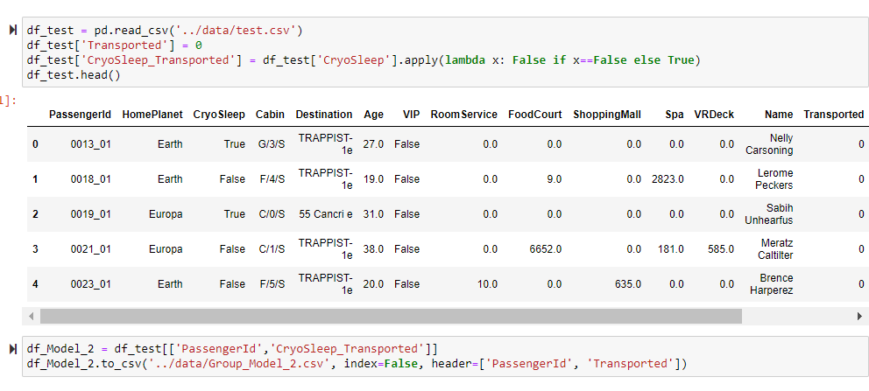
Model 2 (Naïve Buyes)
Simple model for prediction small amount of efforts for preparing data
Not as accurate as decision tree but in short time best option

Slide 9
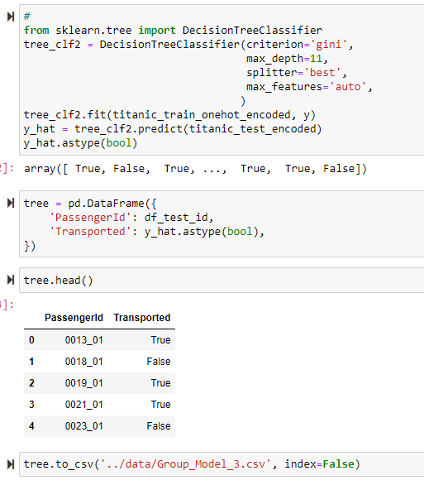
Model 3 (Decision Tree Criteria = Gini)
Other criterion is gini, also good model but less accurate then entropy, also has another peak of accuracy depth is 11
Good model

Slide 10
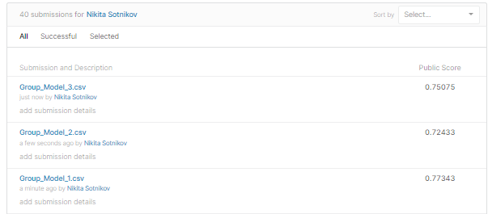
Results of Models
Group Model 1 is Decision Tree with Entropy Criteria
Group Model 2 is Naïve Buyes
Group Model 3 is Decision Tree with Gini Criteria

Slide 11
Results of Models
Using many trials best model is “Decision Tree”
Best criterion is “entropy”
Best max features is “auto”
Best splitter is “best”
Best max depth depends from criterion for gini is “11” for entropy is “9”

Slide 12

Methods used
Visualization
Data Manipulation
Summarization
Preprocessing
Tidying Data
Data Analysis

